Slide 1
Intranet Workshop
<Customer Name>

Slide 2
Setting the scene…
Where are we headed and why?
Notes:
Chrissie and Caleb – 5 minutes

Slide 3
WHAT?
Communicates and amplifies our values
Brings people together and fosters a sense of #teamplayers across geography, role and interests
An easy way for people to stay up to date with what is happening
An easy and obvious way for people to self-serve for information that helps them do their jobs
A showcase of how we use the great tools we deploy for customers.
Notes:
EXAMPLE what slide

Slide 4


Hopes and dreams
Leveraging the power of teamwork
what will you be proud to share about our intranet? how has it made “your work better”?
Notes:
Let’s unpack: OPTION ONE

Slide 5
Hopes and dreams
Leveraging the power of teamwork
The intranet meets the goals and is a wild success. Six months after go-live, someone asks you what internal projects you have been involved with and the impact it has had at Information Leadership…
Notes:
Let’s unpack: OPTION TWO

Slide 6
Cover Story…
Cover – tells the big story of your success​
Headlines – convey the substance of the cover story​
Sidebars - reveal interesting facts of the cover story​
Quotes – can be from anyone but must be related to the story​
Brainstorm – for documenting initial ideas for the cover story​
Images – supporting the content with images​
Notes:
Lets unpack…. (OPTION THREE)

Slide 7
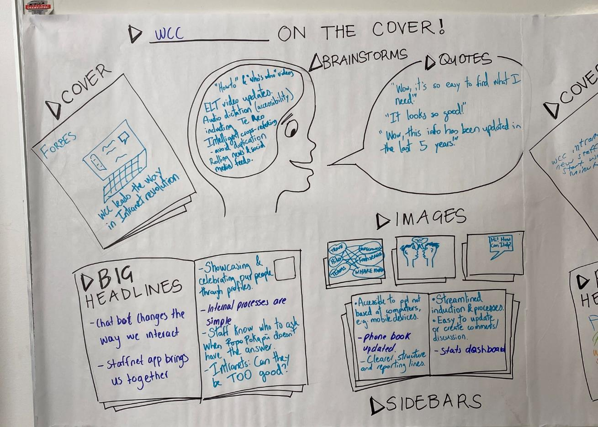

Slide 8
























Slide 9
Process and expectations
How will we deliver it?
Notes:
Chrissie and Caleb – 5 minutes

Slide 10
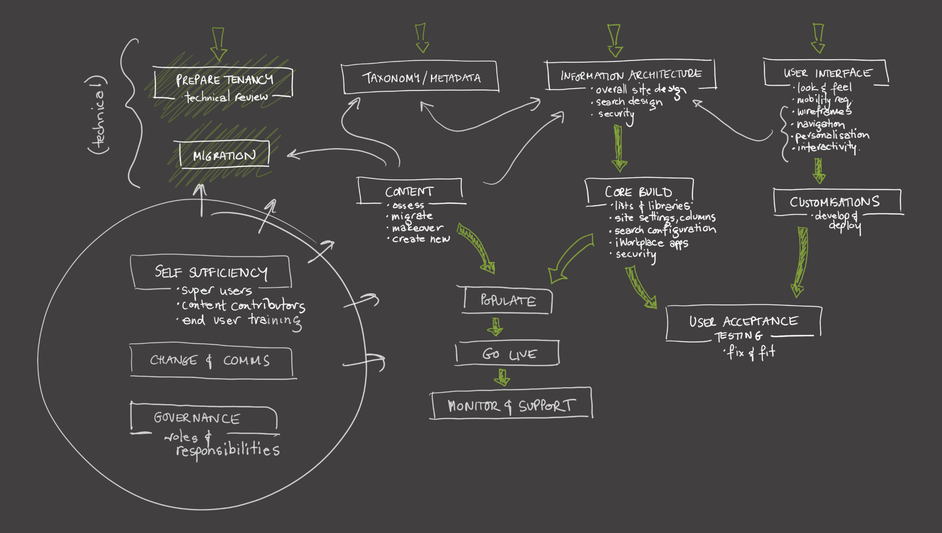

Slide 11
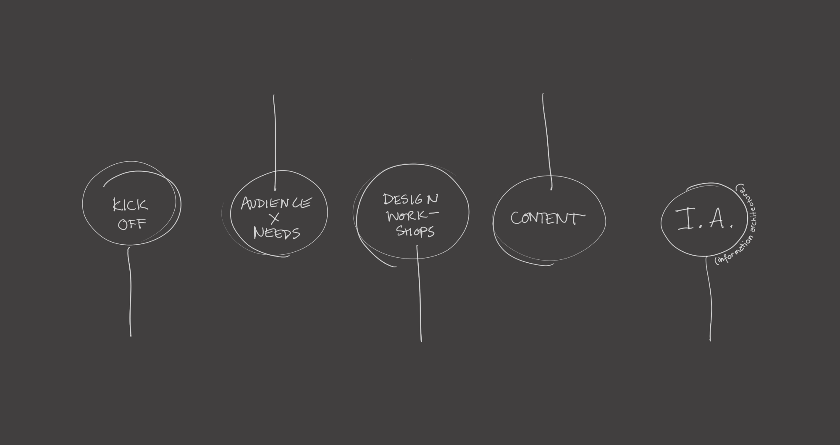
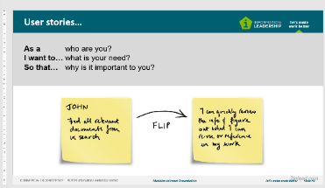
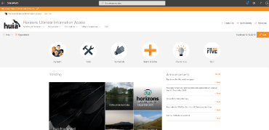
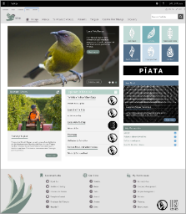
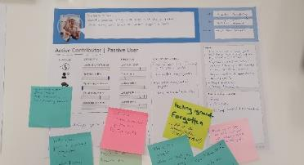
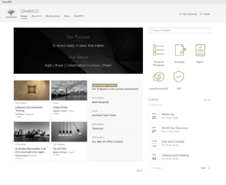
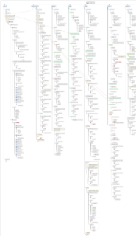
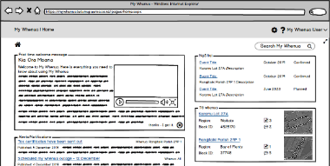
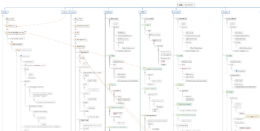
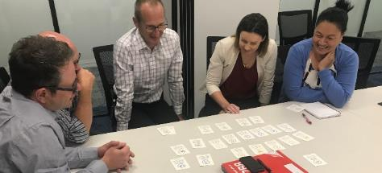
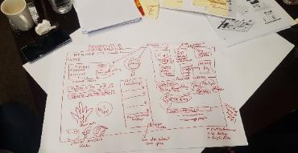

Notes:
Brainstorm with the group ways they think they can be involved in this project.

Slide 12
Ways this group will be involved?
Notes:
Brainstorm with the group ways they think they can be involved in this project.
Evangelism
Information architecture and design
Content preparation and creation
Power users
Training and coaching peers
Communication and change management

Slide 13
How could we stuff this up?
Two options: straight up brainstorm
OR
Pre-mortem exercise (next four slides)
Notes:
“Now we know everything we can about this project, about what it will take to succeed, about the deadlines and the team involved. Take a moment to think about other projects you’ve worked on like this in the past, and everything we must accomplish to make this project a success. Based on your experience, what might go wrong and cause the project to fail?”

Slide 14
Pre-mortem
An innovative research-informed method of preventing the failure of any project. It uses ‘prospective hindsight’ to identify reasons a project could fail. [from Mitchell et al 1989]
Imagine the project has already failed spectacularly
Identify ALL the possible reasons this failure has happened
Address each reason with a clear action
Notes:
OPTION Two

Slide 15
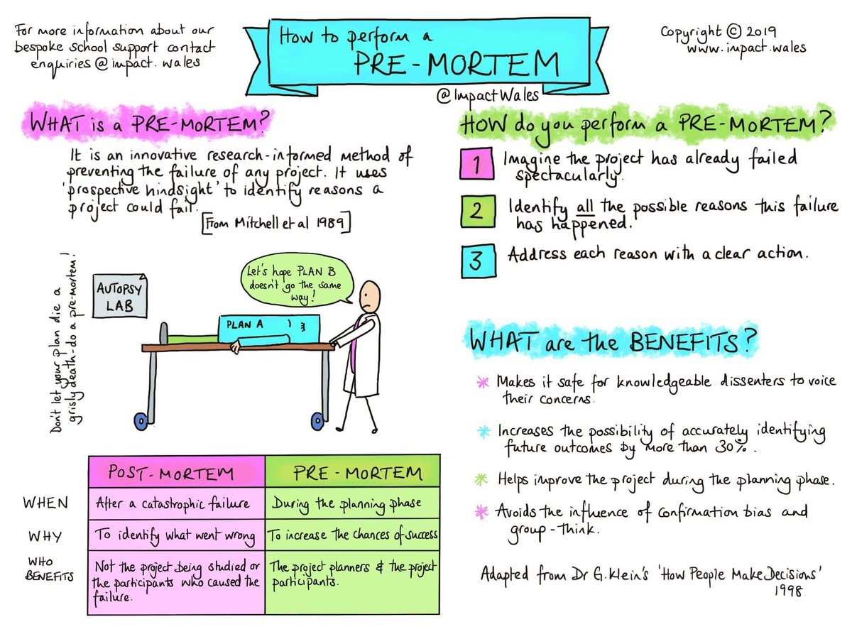
Pre-mortem
Notes:
OPTION THREE

Slide 16

















Slide 17
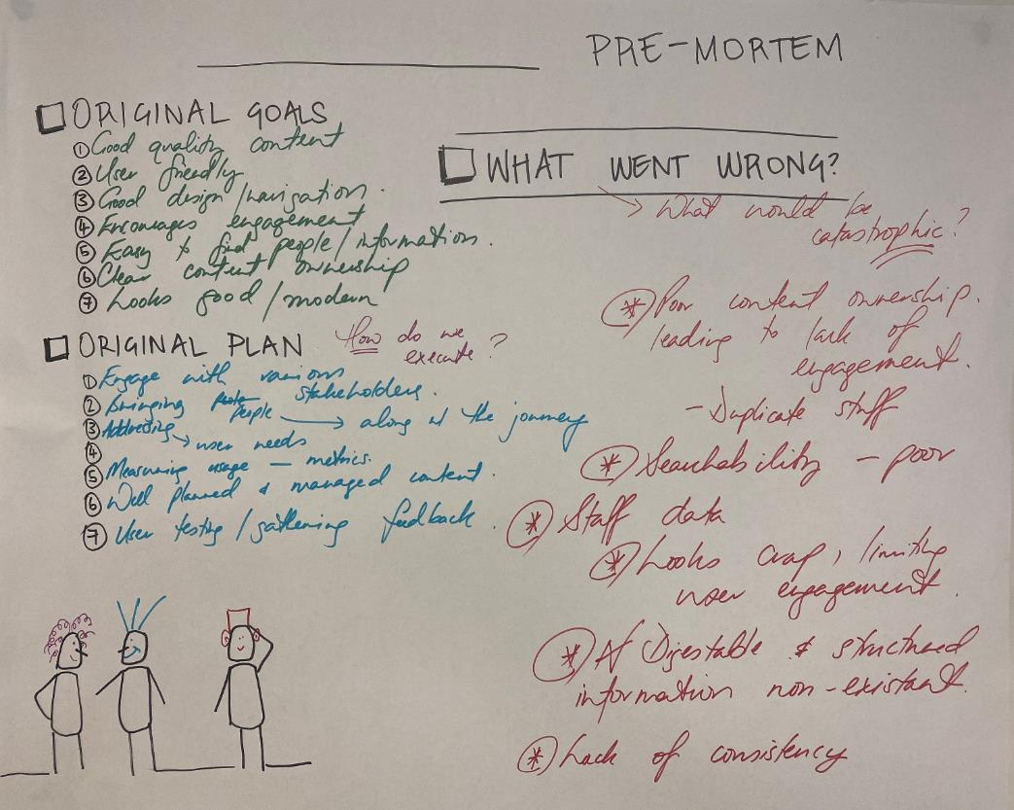
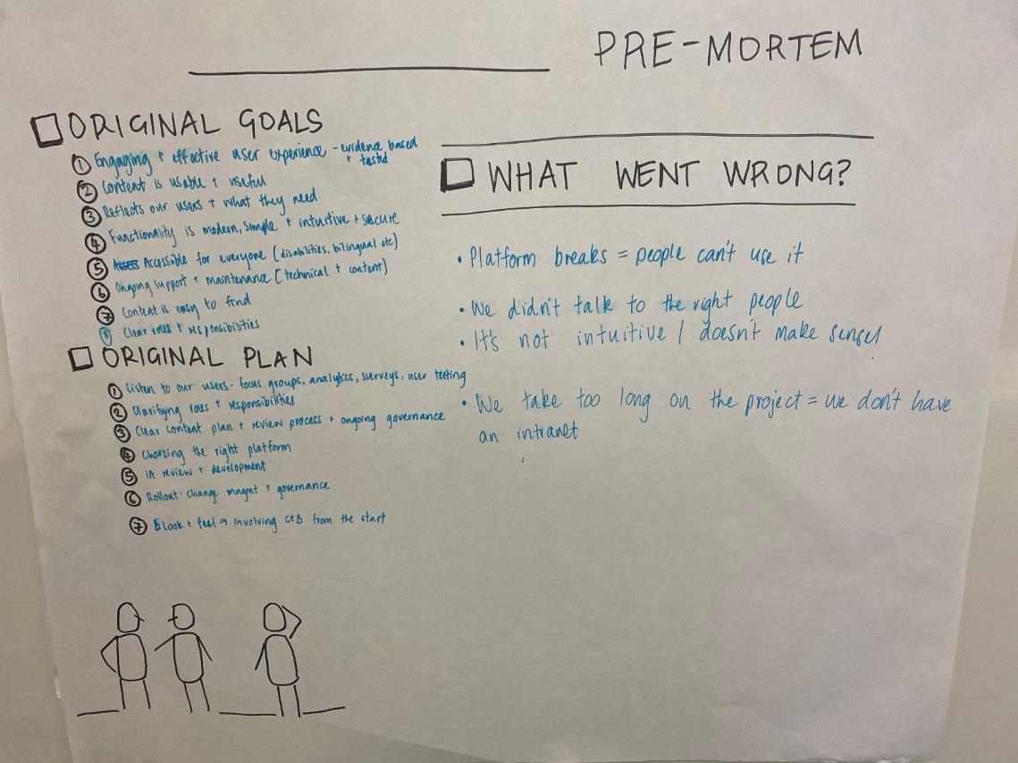

Slide 18
Microsoft 365
What is it?
Notes:
Hear to talk about a solution to a problem that has been holding back Office 365 use for business critical doc mgmt

Slide 19


















Microsoft 365
Notes:
Big box of lego, you’ve got a lot of apps that provide you with new ways of working and may different ways to collaborate, communicate and get work done.
Just like building a lego tower, you cannot start from the top, you must start from the bottom, so that we can build a foundation for our digital workplace get the basics right, ensure it’s the right fit for our staff and once we are comfortable in using the system, you will naturally start asking for more functionality and continuous improvement

Slide 20
Set-SPOHomeSite -HomeSiteUrl <siteUrl>.
Bringing it all together...
Home site
News & pages
Templates
Authoring
Authoritative news
Approvals
Audience targeting
Scheduling
Version control
Images
Org assets
Communities
Video

Slide 21



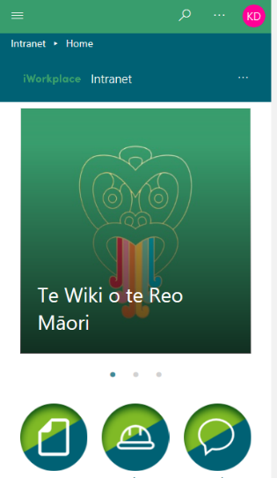
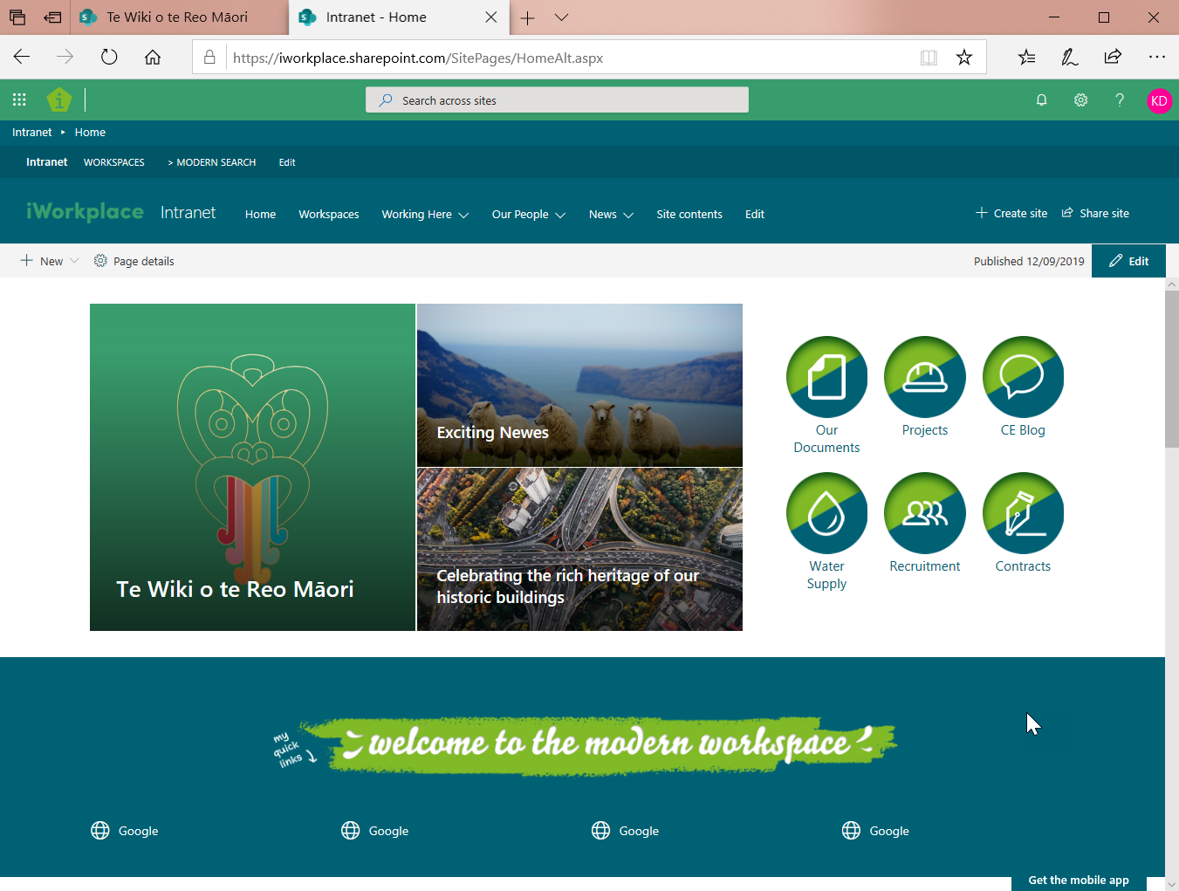

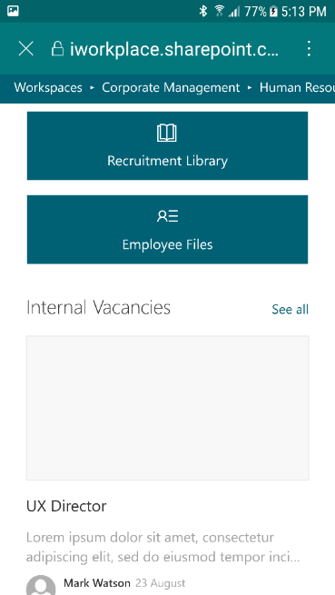
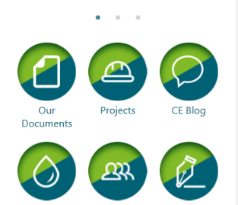

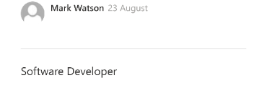
Modern SharePoint
<caption>
Notes:
So modern SharePoint… when should we use it? SHOULD we use it? Let’s take a look at what it promises and where it delivers.

Slide 22




Go Live
What have we discovered?
Two way engagement likes, comments, social sharing
Easy & intuitive looks great
flexible
Personalisation audience targeting
Mobile first
it just works
Harder to get it wrong. Easy to do the right thing. Faster than ever to provision AND never been more user friendly
Notes:
So what have we discovered?
It’s easy and intuitive. Faster than ever to provision AND never been more user friendly. We wanted to push the boundaries of what’s actually possible and the results of that are in the demo that we’ll look at shortly. Our team put this together in under a week. And it looks great.
Users can engage with content via likes, comments and social sharing. Micro sites increase flexibility and combined with how easy content is to author, provide good opportunities for building communities of users. This was pretty clunky before.
Personalisation options include curating targeted content for specific audiences as well as Microsoft ‘recommended’ content feeds for news etc. We’ll see that a bit later.
And modern SharePoint has been built from the ground up with mobile in mind. Whether you are using a web browser or the SharePoint app, It actually does ‘just work’.
Its harder to get it wrong and easy to do the right thing.

Slide 23
Reduce publishing friction
Author news and pages
Templates
Rich content
Inherited metadata
Organisational asset libraries
Authoritative news sites
Easy to link to news outside my org
Auto synopsis and image
Promote other content
Email out a digest
Hero news
Easy & intuitive looks great
flexible
Notes:
So I’m a senior leader in my organisation, I want to post some important information about a new organisational initiative called Project Zenith.
Navigate to our Leadership Team news site. Create a new post > I can use this template that’s been provided for me (or I could start from scratch). The template already has the custom header for our leadership news site. I can give it a name, add my information to the page, and update the content.
Change the image > I can go straight to our own internal images hub (I don’t’ need to mess around with uploading my own image if I don’t want to). Then I publish my post. I don’t need to update the page synopsis or thumbnail image, SharePoint does it for me, as well as any retaining any default metadata I might have set up in my template.
So along with the internal announcement about my project, I know that a video has been released to the media. I want to share this via Media Releases on the intranet. News Link: https://www.youtube.com/watch?v=uRyzxIqhR4U All I really need to do is paste the link… [Mark]: Benefits….?
I can also easily promote other types of content – the new project is going to require some security changes and a good place to start is to remind people about the current requirements for password resets. Browse to working here > password policy… Edit text then publish and click on promote.
When I navigate to the main news page > there are all three of my posts. We can see that the project zenith news has come from an ‘Authoritative news site’. Our video click through is showing up there under Media releases as well as our working here page about passwords.
And at the end of the week, I can click through to see all the news for the intranet and I can create an email digest to send out at the end of the week.
Finally, this new initiative is headline news > I can easily make this the hero on my homepage. (search for item, make it the main post).

Slide 24
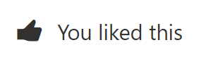

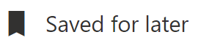
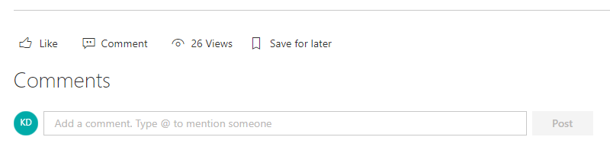
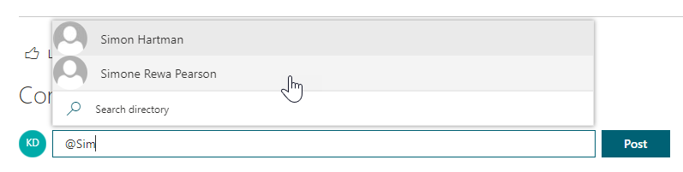
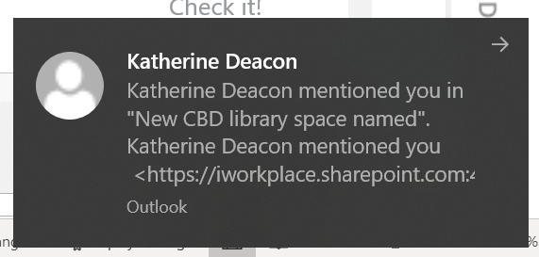
Two way model
Likes, comments, @mentions
Communities
Two way engagement likes, comments, social sharing
Notes:
Navigate to the community engagement post (soccer image)
By default, users can engage with content in the social bar at the bottom of each page (we can turn this off where appropriate). But I can like, comment and @mention my colleagues. If I @mention them, they’ll get a notification in SharePoint or via email.
[Mark can you comment on a page while I’m doing this so that I get a notification?]
Slide with screenshots in case issue with the demoSlide with screenshots in case issues with the demo

Slide 25

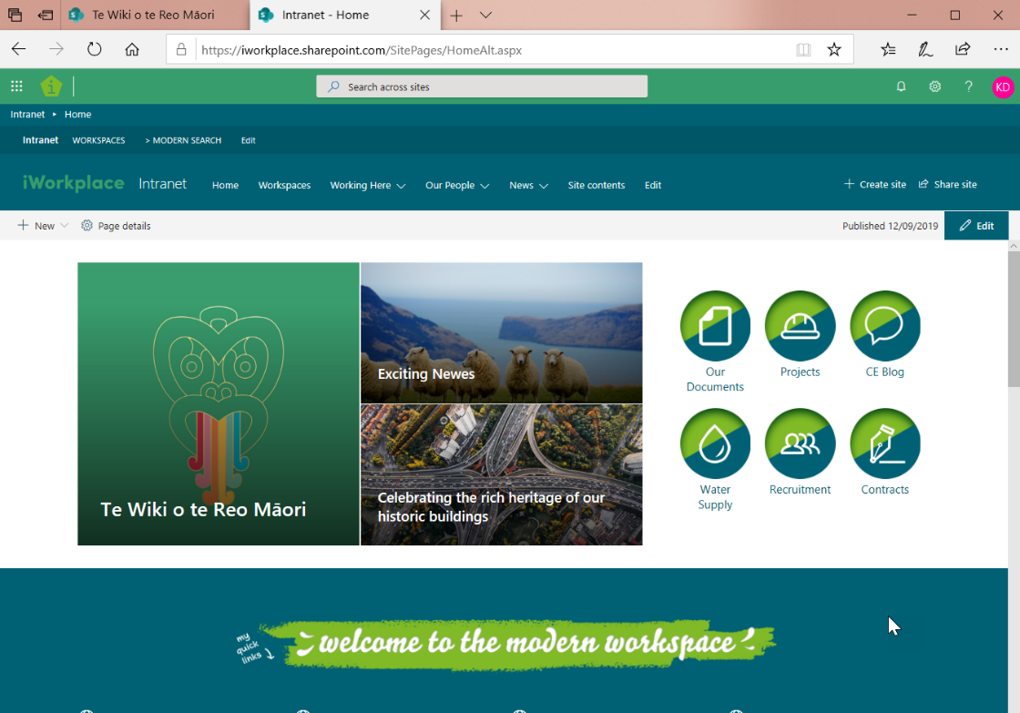
Go Live
Mobile ‘just works’
Mobile first
it just works
Notes:
Here’s our homepage.
And here it is in the browser on a mobile device… and our recruitment workspace in the mobile app.
This is that same demo site that it took us only 170 hours to put together.
Obviously when you create a demo, there aren’t any curly user requirements (except for the boss), so its much faster because you can do whatever you like; but the point is that before, we would have to decide whether we want to handle on the server or client side, painstakingly install the pnp responsive framework and handcraft responsive page layouts, – you get the picture.
If you’d like to take a look on an actual mobile, then you can grab either of us after…
Technology is only part of the story though, right? Even if you have all the tech and great content, you need your users on board! Mark has been working with a customer recently, that has really nailed change and governance for their intranet and EDMs…

Slide 26
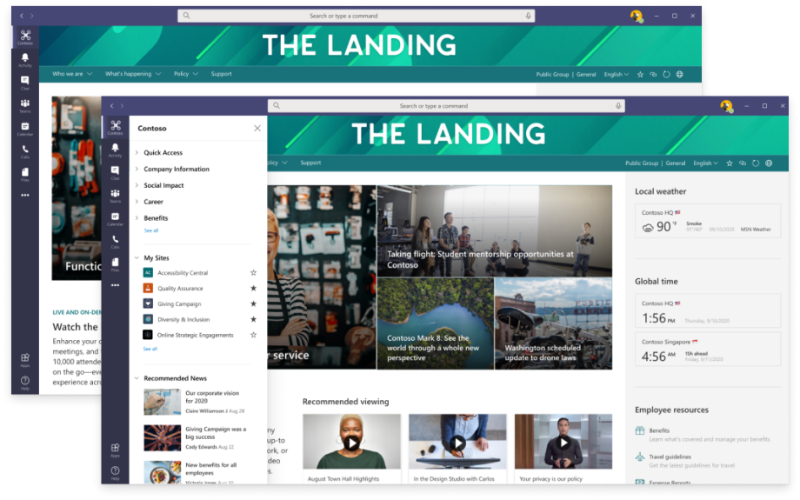
SharePoint and Teams... Better together
Notes:
Home site app for Microsoft Teams ensures that staff can access the intranet in Teams as well as via SharePoint. A video with more information can be found here.
The app provides an immersive site consumption experience, complete with navigation, menus ad support for tenant wide search.
With the home site app, people can tap into news and resources across the intelligent intranet without leaving the hub for teamwork. And communicators can build and deliver rich communications experiences in Teams.
Expected release is MARCH 2021

Slide 27
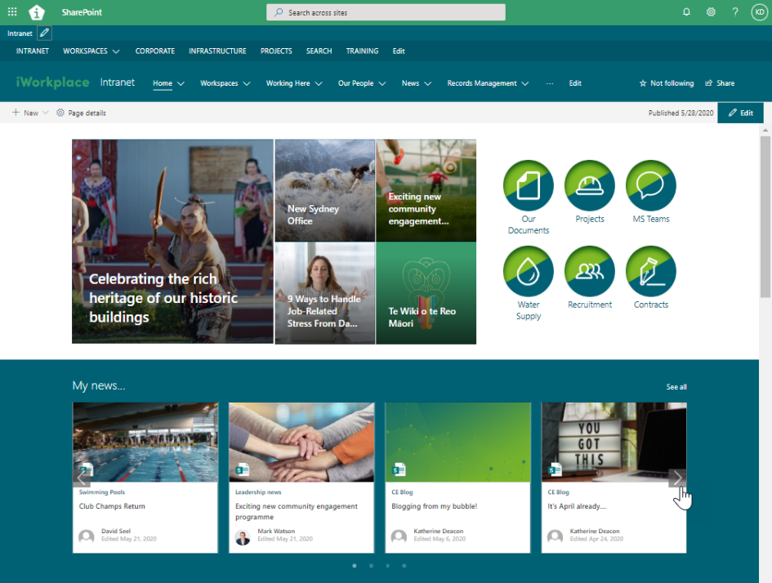

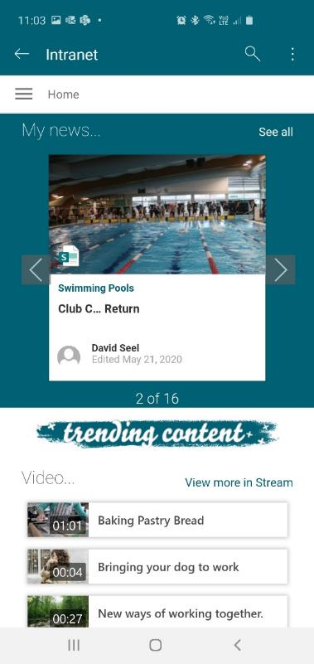
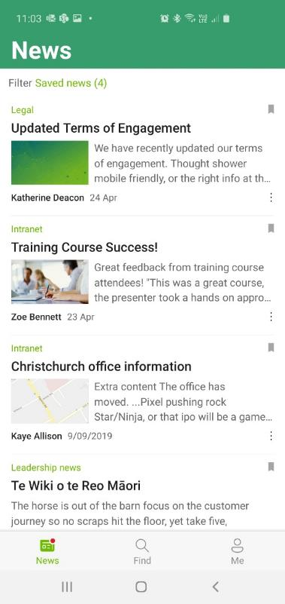
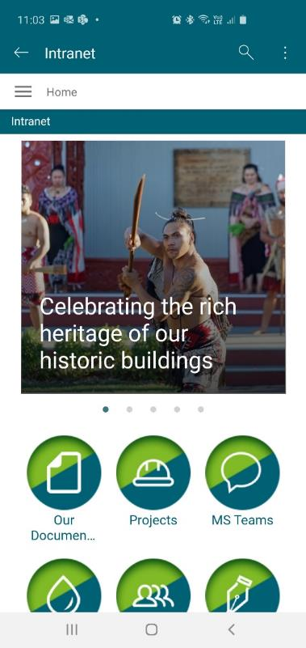
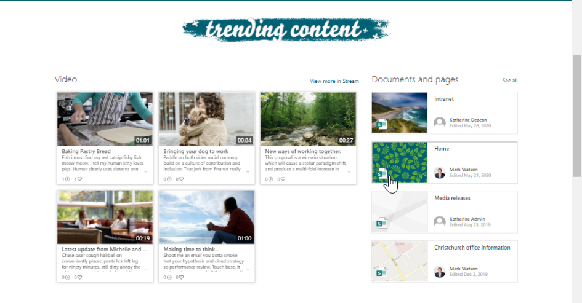
Browser
SharePoint App

Slide 28
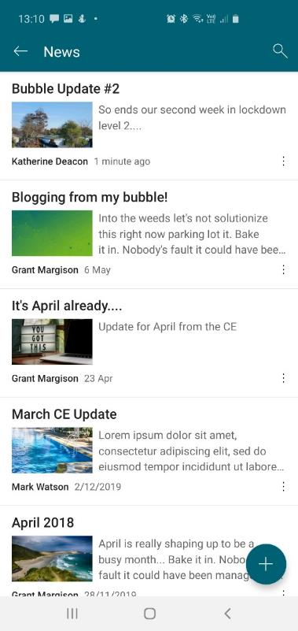
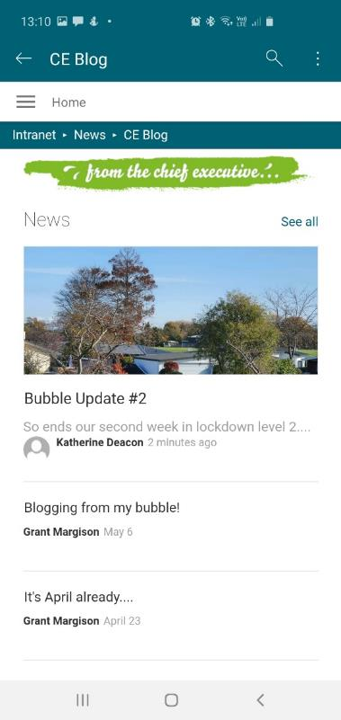
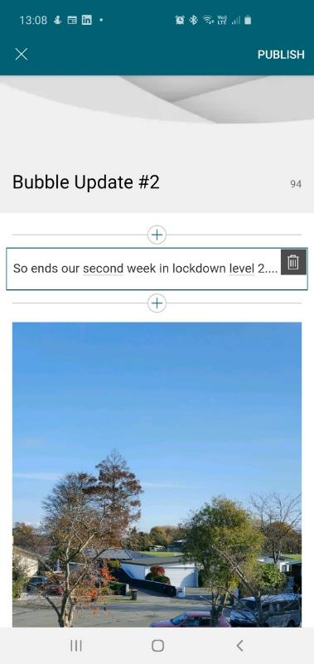

Slide 29
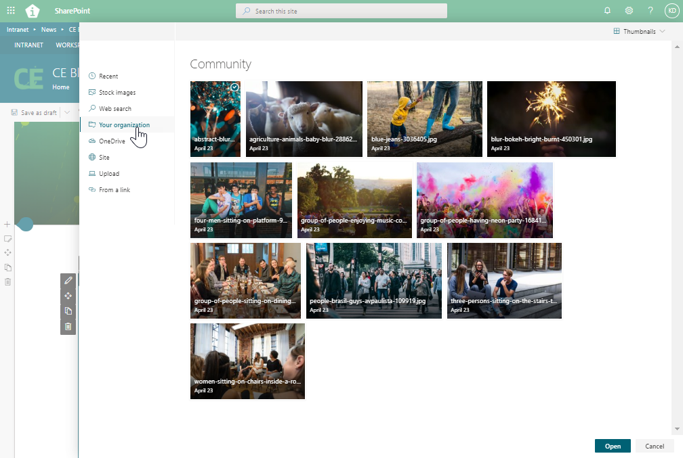
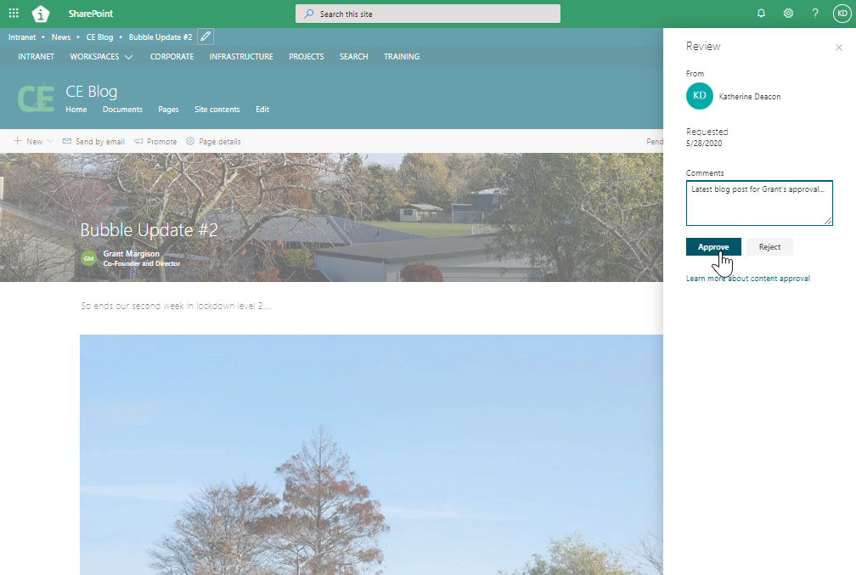

Slide 30
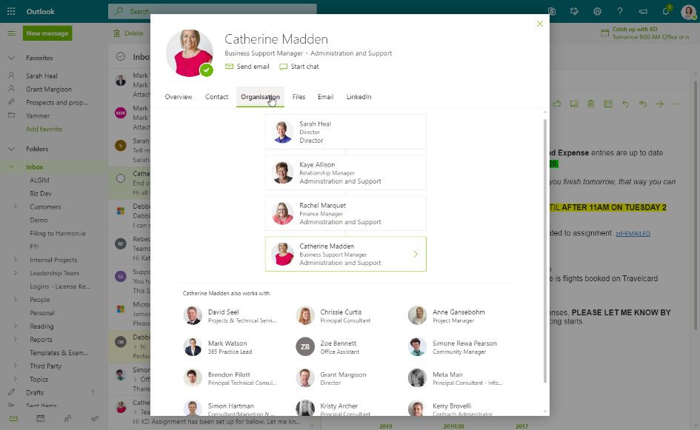
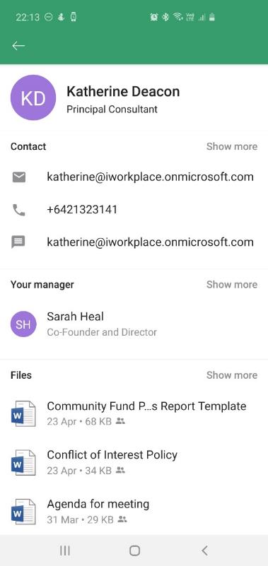
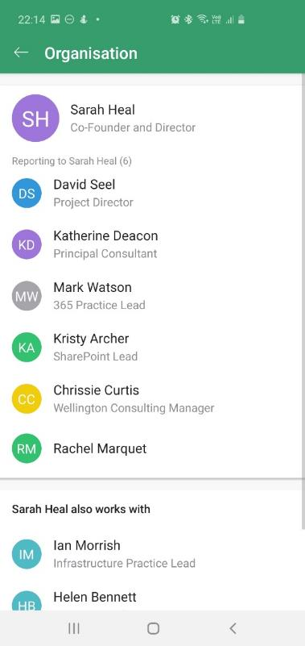
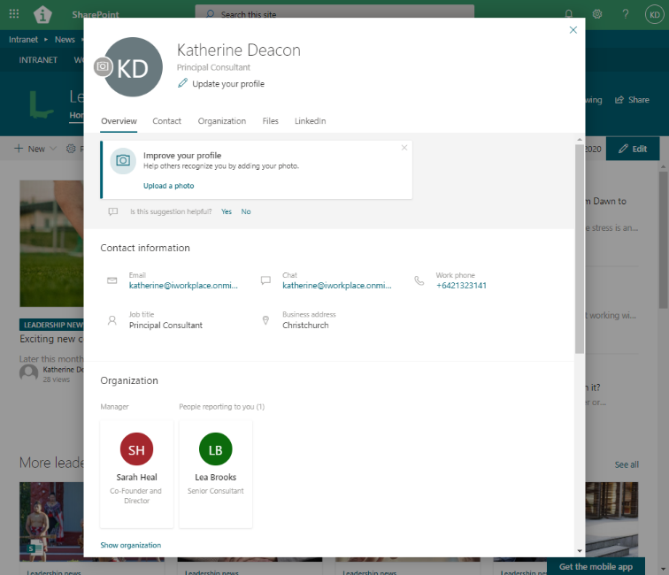
SharePoint
Outlook

Slide 31
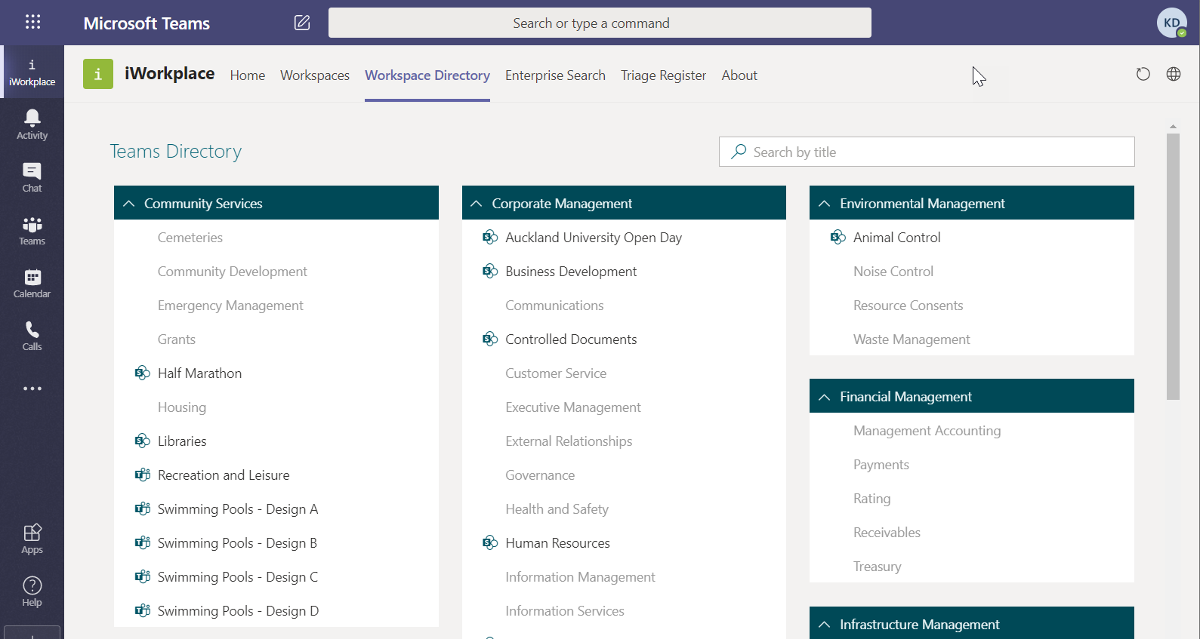
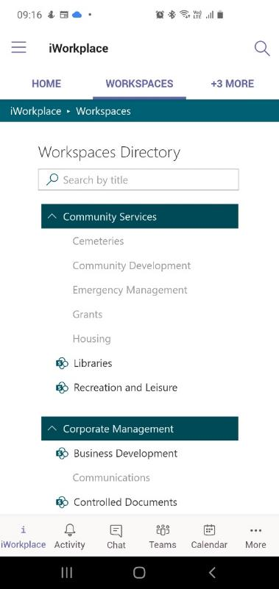
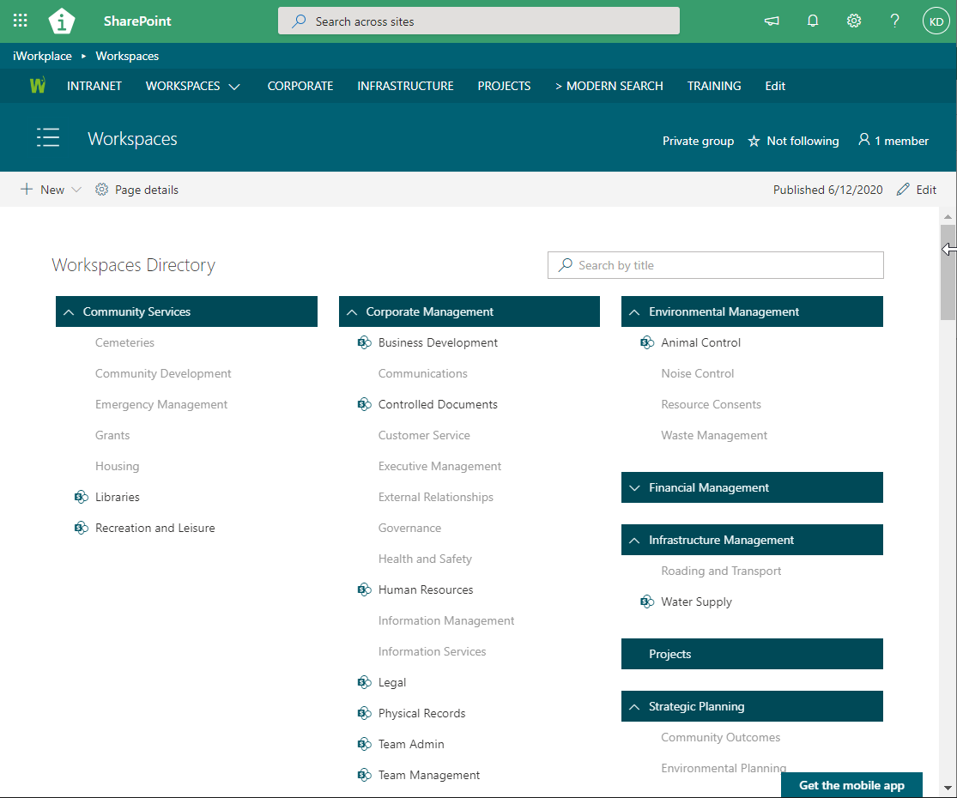
Teams App

Slide 32
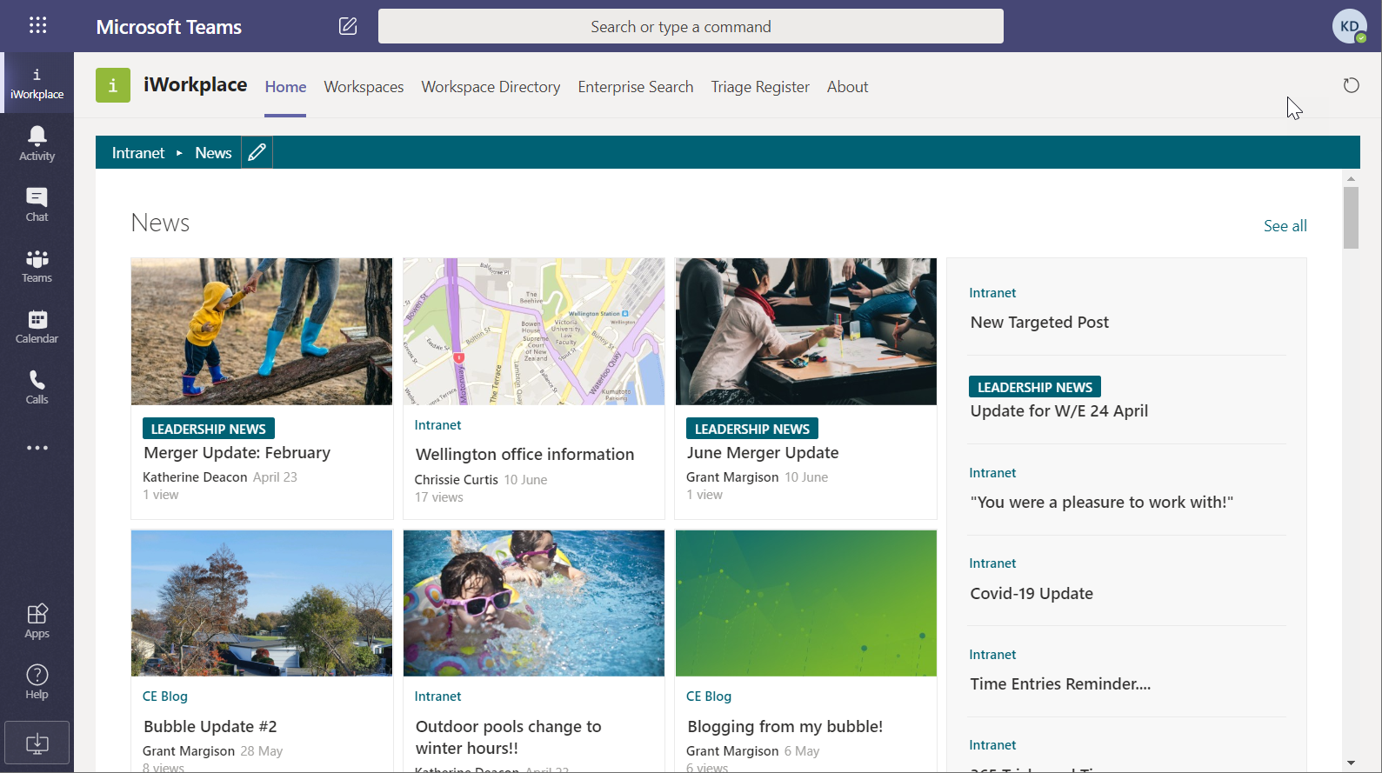
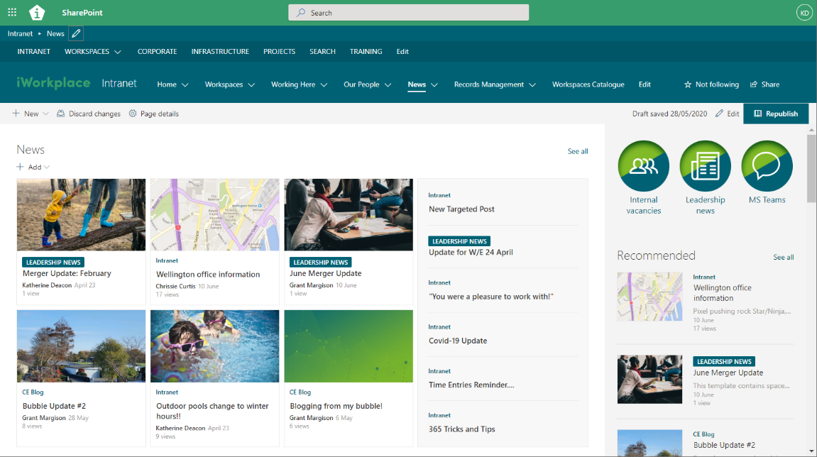
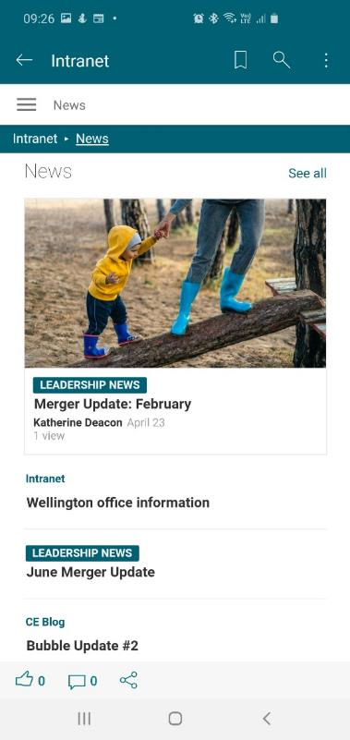
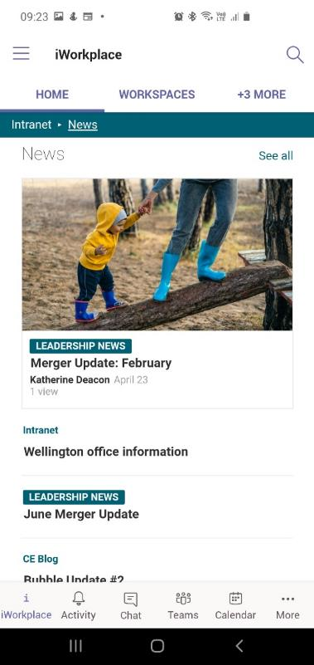

Slide 33

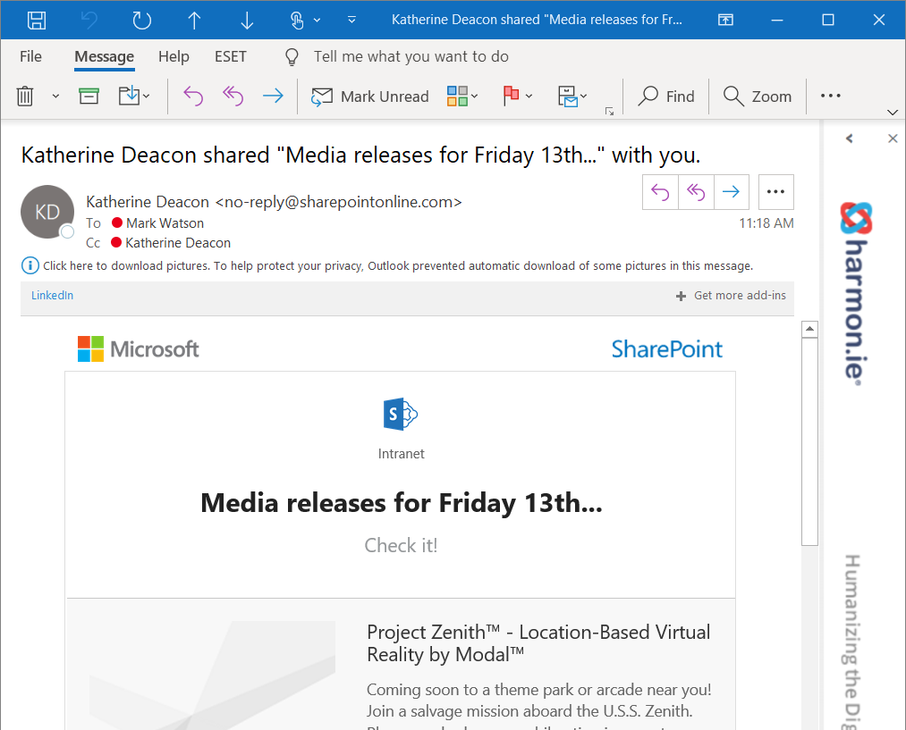


News Digest
Engage with employees that don’t have ready access to the intranet…
…without the extra work
Notes:
New screenshot with the image in it…

Slide 34



Notes:
Let’s look at some scenarios
Chat – in the browser, on my phone, in my pocket

Slide 35


Slide 36




Slide 37
Methodology and approach
Design Process

Slide 38









Lets target your business priorities
Being more competitive
Enabling a culture of innovation and learning
Minimising the learning curve
Making new people productive & safe
Increasing consistency
Driving down rework, risk and hassle
Geographically or Silo Distributed but act as
“One” Organisation
Know what’s happening and not
Measures & Indicators
pick your top three
Efficient and information where it is needed
Working in the field & offline
Engaging with customers/partners
Effective interaction over a wide range of channels
Reducing Risk of Information Accidents
How to build “Our way” of managing crucial information
Knowing what crosses your borders
Managing risk and customer relationships

Slide 39











HW Richardson Single Source of Truth, Support ongoing growth & alignment
Being more competitive
Making new people productive & safe
Increasing consistency
Working as “One” Organisation
Let’s target your business priorities
Measures & Indicators
Working in the field & offline
Engaging with customers / partners
Largest privately-owned NZ transport company
Runs over 60 transportation companies
2000+ staff
NZ and now Australia
Ready mixed concrete, transport, logistics, …
Reducing Risk of Information Accidents
Knowing what info crosses your borders
Notes:
Manage these correctly in modern ways

Slide 40


Under the hood IA for complex organisations

Slide 41

A day in the life… with your Digital Workplace
COLLABORATE
Presence/IM/Voice
Team Co-ordination
Communities of Practice
Shared resource booking
Project/other collaboration
Social tools
CONNECT
Corporate comms
News & Events
Who to contact about what
Contact details
Experience/qualifications
Social media
COLLABORATE
CONNECT
OUR DIGITAL WORKPLACE
DELIVER
PROCESS
DELIVER
Creating & sharing Documents
Managing/finding important Email
Drawings & Photos
Case file & Project management
Scanning paper records
Managing paper
PROCESS
Business process & workflow
Online forms
Online services
Access/integration to online systems
Data reporting & Dashboards
Business Intelligence
CONTROL
CONTROL
Key documents
Forms & templates
Knowledge Base
How to Guides / Videos
Master Data

Slide 42







ALL PAGES

Slide 43






Surfacing Content: Topic = “Emergency”

Slide 44


Shop Front / Back Office
Notes:
Shop Front: context, inviting, easy to find and view
Back Office: super organised, formal processes, governance
We will be thinking about the shop front (your back office is in Tech1?)

Slide 45
Taxonomy

Slide 46

What about metadata
Business Classification(s)
Corporate Services
Human Resources
Topic Metadata
Recruitment
Topic keyword
Landing Page
Job #1254
e.g. Opening Hours
e.g. Recreation; Our Services
Business Metadata
File/page name
Document Type
Social Metadata
Associated Entities
Likes
5 star rating
Informal tags
Favourites
Newsfeed # @
Alerts
Business or functionality specific
System Metadata
Created & Modified when & who
Security
Version; approvals
Recordkeeping metadata
Notes:
Fix slide

Slide 47

Business Metadata matrix
ORGANISATIONS
LOCATION
EMPLOYEE
PROJECT
BUSINESS
CONTEXT
CONTRACT

Slide 48

Categories + Topics
Mmmmm… Bacon + Maple Cupcakes…
maple
cupcakes
bacon
Baking

Slide 49
Categories and Topics
Categories
Static
Small number (4-7)
Cover the main types for News, Events, Pages
Topics – FAQ, A-Z
Hierarchy, ragged, multiple select
Surfacing / curating content…

Slide 50



Intranet Taxonomy…why do we need one??
Pages, documents and items can be surfaced using metadata values in webparts
If no taxonomy, content limited in where it is being “surfaced” and users must browse to the content
Results in “silo’d” group sites with own structures
Notes:
Wikis – Wiki Library in subsite (distributed) versus Enterprise wiki library (centralised)

Slide 51
Surfacing Content: Topic = “Emergency”

Slide 52



Search
Notes:
Kd to figure something out here

Slide 53


Shop Front / Back Office?

Slide 54
Shop Front / Back Office
Notes:
Shop Front: context, inviting, easy to find and view
Back Office: super organised, formal processes, governance

Slide 55
User experience
What kind of experience will our users have?

Slide 56
What does that mean for?
mobile requirements
page layouts
look & feel
accessibility
search
navigation
content
Notes:
If time, get the team to brainstorm what aspects of the intranet we might need to consider when designing the user interface.
Look & Feel: branding, fonts, colours, styles, images
Mobile requirements: how do users interact with the intranet when not at their desk?
Accessibility: how will we make sure the intranet is accessible to everyone?
Page layouts: what will be on the pages and where?
Search: searching and refining
Navigation: how to get around, global & local navigation, quick links, favourites, footer...
Content: what information do our users need / want?

Slide 57
EXERCISE
Leveraging the power of teamwork
how could we stuff this up?
Notes:
The flip side…

Slide 58



Audience targeting
What? Group of users with common characteristics like geographic location, role or particular interest.
Why? helps the most relevant content get to the right people.
Where? Navigation, footer, site pages, news and highlighted content.
But…
audience targeted
audience targeted
Notes:
Explain what it is and then a demo of how it works
https://support.microsoft.com/en-us/office/overview-of-audience-targeting-in-modern-sharepoint-sites-68113d1b-be99-4d4c-a61c-73b087f48a81
BUT while VERY useful, categorising our users into audiences (or demographics) doesn’t really help us understand what makes them tick...

Slide 59





How do you like your coffee?
milk & sugar
just black
iced coffee with milk
espresso with sugar
latte please
Hot | ✓ | ✓ |  | ✓ | ✓
Sweet | ✓ |  |  | ✓
Creamy | ✓ |  | ✓ |  | ✓
2tolead.com
Notes:
> dividing a population into representative user groups to better identify and serve their needs
> one group today, another group tomorrow…

Slide 60

What are personas?
what’s their story?
what type of user are they?
what would motivate them to use the intranet?
what are their main goals when using the intranet?
how comfortable are they with technology?
What frustrates them about their day-to-day?
2tolead.com
Notes:
> Understand and identify the key user types within your organisation

Slide 61
EXERCISE
Leveraging the power of teamwork
personas
Brainstorm the personas
Create your persona cards...
Explanations: what is a passive user vs an active contributor?
Channels?
Sliders?
Examples
Go!
Notes:
The flip side…

Slide 62






Primary intranet personas..
“My goal is…
Name
Role
Audience
Active Contributor | Passive User
Needs:
CHANNELS
ATTRIBUTES
BEHAVIOUR
MEASURES OF SUCCESS:
Leadership / Influence
Communication
Technical ability
Connection
Barriers and pain points:
Technology avoidance
Collaboration
Social engagement
Consumption
Openness to change
Contribution
2tolead.com
Notes:
> Intranet users typically fall into one of the 5 C’s

Slide 63
EXERCISE
Leveraging the power of teamwork
audience needs
Split into groups and choose a persona
You’ll be given sticky notes & a marker
Write down TEN needs or pain points relevant to your persona
For each, indicate WHY this is important to you
Notes:
The flip side…

Slide 64




User stories…
As a
I want to…
So that…
who are you?
what is your need?
why is it important to you?
2tolead.com

Slide 65


Understanding needs & pain points
As a I want to so that .
who are you? what is your need? why is it important to you?
Examples:
As a consumer, I want to know who has what expertise so that I can ask the appropriate person for help.
As a communicator, I want to send out engaging news content so that it is timely and relevant and keeps users coming back to the homepage.
2tolead.com

Slide 66
EXERCISE
prioritisation
Leveraging the power of teamwork
As a group, prioritise each of your Needs and Pain Points using MoSCoW
Choose a representative for your group and have them put your sticky notes on the wall; present your choices.
Notes:
The flip side…

Slide 67

MoSCoW
ust have
ould have
hould have
on’t have
M
C
S
W

Slide 68

Value staircase Tactics
Move up for crucial business solutions
Move up as team buys in & will exploit extra functionality
Solid base to grow from
Notes:
We talk about the value staircase where this solid base is created, staff get used to accessing what they need and overtime the capabilities are built out and functionality expanded.
We are aiming to design, configure and build a solid base to grow from – and move up the value staircase as teams buy in to the new environment and opportunities to exploit available functionality become obvious.

Slide 69
Intranet Delivery and Functionality…
Importance
How necessary is it for Phase One?
Vital
Optional
Nice to Have
Interact Advice
Deliverables Information
Easy
Moderate
Significant
Delivery
How much effort is required?

Slide 70
Content inventory
What do you need?
What do you have?
What is most important?

Slide 71
EXERCISE
Leveraging the power of teamwork
content
Split into groups and choose a persona
Review the prioritised needs or pain points relevant to your persona
For each, identify what CONTENT will help meet that need
Each content ‘item’ on a different post-it. We’ll need these later.
Notes:
The flip side…
As a group, prioritise each of your Needs and Pain Points using MoSCoW. Choose a representative for your group and have them put your sticky notes on the wall; Present your persona

Slide 72
Navigation

Slide 73

What is important to your organisation?
Think about audience needs…
What needs to be accessible at the highest level and makes sense to group together?
Notes:
Before we can work on our intranet taxonomy, we need to know what our content is…

Slide 74

Key Elements - Global Navigation Example

Slide 75



Slide 76
EXERCISE
Leveraging the power of teamwork
navigation
In groups, work together to design your proposed navigation for our intranet:
REMEMBER your colleagues, the functionality and content they will need; and
Global navigation principles.
Present your navigation back to the group

Slide 77
Look and feel
Not just a logo and some colours...

Slide 78
How can we communicate our brand?

Slide 79

Antarctica NZ| Homepage
Notes:
Manage these correctly in modern ways

Slide 80



Wakatū | Intranet pages
Notes:
> what do these intranet pages say about the brand?

Slide 81






Kelston and van Asch Deaf Education | Intranet pages
Notes:
> what do these intranet pages say about the brand?

Slide 82



Slide 83


Slide 84
SharePoint Lookbook: https://sharepointlookbook.azurewebsites.net/

Slide 85










Anatomy of a page

Slide 86
‘The Fold’ – what is it? and why do we care?
Less columns is better
Less fields are better
Guide visitors
Bigger is better
A

Slide 87
EXERCISE
wireframing
Leveraging the power of teamwork
In your groups…
Focus on the audience needs
Brainstorm with sketches and notes 30-45 minutes
Present your best work ☺ 15-30 minutes
Notes:
The flip side…

Slide 88

A day in the life of…
…our HR Advisor
Notes:
The easiest way to illustrate this is to think of a ‘day in the life of’… For this example we’ll look at recruitment and a day in the life of our HR Advisor > Me!

Slide 89





Notes:
When I was getting coffee this morning, I noticed that there has been some activity in the HR Team site… Mark’s skiving off, so I made a note to do his work for him when I get to the office and I change my coffee order to include an extra shot cos it feels like that’s the kind of day it’s shaping into.

Slide 90


Notes:
When I was getting coffee this morning, I noticed that there has been some activity in the HR Team site… Mark’s skiving off, so I made a note to do his work for him when I get to the office and I change my coffee order to include an extra shot cos it feels like that’s the kind of day it’s shaping into.

Slide 91





Slide 92



Critical LOB on different devices/use cases
Web browser
PDF hardcopy or fax
Smart phone

Slide 93
Newby
Name
Role
Audience
Nicole
New staff member
New staff
“My goal is to hit the ground running and get my head around how Horizons works so I can get on with my job”
Passive User
NEEDS:
Horizons roadmap providing detail on process, people, the team, and the organisation.
An easy to access digital platform that will help her find content such as people, documents, training resources and forms.
Information about Horizons values and culture e.g. sport teams, Big5, benefits of working at Horizons, quiz nights and clubs she can join.
BARRIERS AND PAIN POINTS:
Time poor
Limited training
Large amount of information to absorb rapidly
Potential inconsistencies in processes being phased in/out as new intranet platform is rolled out.
CHANNELS
ATTRIBUTES
BEHAVIOUR
Easy to find and up to date information about working at Horizons.
Sense of belonging and connectedness with being a new staff member at Horizons.
Being able to easily access resources about staff contacts, role and organisational structure.
In the loop with current news, events and social/sport clubs she can be apart of.
✓
Leadership / Influence
Communication
✓
Technical ability
Connection
✓
Technology avoidance
Collaboration
Social engagement
Consumption
✓
Openness to change
Contribution
2tolead.com
Notes:
> Intranet users typically fall into one of the 5 C’s

Slide 94


Slide 95


Slide 96
Governance

Slide 97
Principles
Clear Information Architecture role | To adequately fulfil this role, the IA must understand the design principles and the importance of consistency across the deployment.
Limit one offs | All changes to the core design need to be weighed up against their benefit to the entire deployment.
Limit development | Using out of the box functionality or known solutions should always be considered before any one-off piece of development.
Review sites regularly | To ensure that there is continuous improvement it is good practice to schedule regular reviews of each area with the expectation that changes will be made to ensure relevancy and consistency.
Work closely with the Records team | Working closely with Corporate Records team ensures that content is managed in a way that is consistent with legislative requirements.
Metadata | Wherever possible utilise functionality to limit the metadata that users enter.
Reuse designs | Identifying and reusing designs across the deployment is important to retain consistency and give users a sense of cohesion.
Manage site and library templates | Centrally manage templates to retain consistency and ensure that each build is completed to a basic standard.

Slide 98
Roles and Responsibilities
What are the existing intranet roles and responsibilities?
Reporting requirements
Content approval/validation requirements
Resourcing - assist/input into design and builds
Content clean up and apply metadata
Communicating / managing the change
Training (planning, train the trainer etc.)
Notes:
Who will manage existing content?
Who will create new content?
Who will control/have rights to update/add/approve?

Slide 99

Controlling the Sprawl
Governance
“…and then there came a band of warriors called intranet managers, armed with standards, governance models and an eye for usability…”.
Who will manage existing content & news?
Who will create new content?
Who will control/have rights to update/add/approve?
Keep it simple
Identify power users
Enthusiastic, potential floorwalkers

Slide 100
Governance - Control Processes and Documentation
Evaluating requests
Making changes
Governance decisions
Roles and Responsibilities definitions
Design Principles
Site Design Documentation (site maps, wireframes, pages inventory etc)
Naming formats
Approval/validation process
Capturing issues and resolutions
Notes:
Discussion on current processes for…..
Identify any areas in need of tightening up, updating or improving on…..

